Slide 1
College bot – mahfooz bot
CAPSTONE PROJECT
Presented By: Md Mahfooz Alam Ansari
Student Name- Md Mahfooz Alam Ansari
College Name- CSET
Department- EE

Slide 2
OUTLINE
Problem Statement
Proposed System/Solution
System Development Approach (Technology Used)
Algorithm & Deployment
Result
Conclusion
Future Scope
References

Slide 3
Problem Statement
Problem Statement : In the college setting, accessing timely and comprehensive information about Courses , fees structure , branches ,exams, results, course durations, placements, and more is crucial. Current methods may be inefficient, leading to frustration. To address this, we need a chatbot that can provide instant, personalized responses to inquiries and also engage parents in the process. This solution aims to streamline communication, empower students, and enhance the overall college experience..

Slide 4
Proposed Solution
- Data Gathering
- Natural Language Understanding (NLU)
- Dialog Flow Design
- User Interface (UI) Development
- Deployment
- Testing
- Continuous Improvement
- Results

Slide 5
System Approach
System Approach with IBM Watson Assistant:
- Agile Development: Iterative approach for continuous improvement.
- NLU Integration: Utilize Watson NLU for accurate interpretation.
- Dialog Flow Design: Intuitive design for smooth user interaction.
- Cloud Integration: Seamlessly integrate with IBM Cloud services.
- Continuous Training: Regular refinement based on user feedback.
- Security Compliance: Adherence to IBM Cloud security standards.
- Performance Monitoring: Ongoing monitoring for optimization.
- User-Centric Focus: Prioritize user experience and satisfaction.

Slide 6
Algorithm & Deployment
- Algorithm Selection: Choose appropriate algorithms such as decision trees, logistic regression, or neural networks for chatbot training based on the complexity of user queries and available data.
- Training Data Preparation: Prepare training data by labeling examples of user queries and corresponding intents or actions to train the chatbot model effectively.
- Model Training: Train the chatbot model using the prepared training data and selected algorithms to learn patterns and relationships between user queries and responses.
- Evaluation and Validation: Evaluate the trained model's performance using validation data to ensure accuracy, precision, recall, and other relevant metrics meet acceptable thresholds.
- Deployment Strategy: Select a deployment strategy based on the requirements and constraints of the deployment environment, such as cloud-based deployment using IBM Cloud or on-premises deployment.
- Cloud Deployment: Deploy the trained chatbot model on IBM Cloud using Watson Assistant for scalable and reliable chatbot service delivery.
- Configuration and Integration: Configure the deployed chatbot model to integrate seamlessly with existing systems, platforms, and communication channels to provide accessible and efficient user interaction.
- Continuous Monitoring: Implement continuous monitoring of the deployed chatbot to track performance metrics, detect issues, and gather feedback for iterative improvement.
- Version Control: Maintain version control of the deployed chatbot model and associated resources to manage updates, rollback changes, and ensure consistency across deployments.

Slide 7
Result
Our chatbot revolutionizes the college experience for both students and parents, offering instant access to essential information with just a few clicks or taps. Imagine effortlessly finding course details, exam schedules, and even placement opportunities—all at your fingertips. Designed with simplicity in mind, our chatbot is as easy to use as sending a text message, making it accessible to everyone. With the power of IBM Cloud behind it, you can trust that the information you receive is always up-to-date and reliable. Say goodbye to endless searches and confusion—our chatbot is here to make your college journey smoother and more enjoyable for both students and parents alike.

Slide 8
Conclusion
Our proposed chatbot solution has successfully revolutionized the college experience by providing students and parents with instant access to essential information. Through seamless integration with IBM Cloud and Watson Assistant, users can effortlessly retrieve course details, exam schedules, fees, and placement opportunities. The user-friendly interface ensures accessibility for all, making navigation intuitive and straightforward. This has led to increased engagement, empowerment, and satisfaction among users, ultimately enhancing the overall college experience.
Challenges Encountered:
During implementation, several challenges were encountered, including data integration complexities, fine-tuning natural language understanding, and ensuring seamless deployment on IBM Cloud. Additionally, managing user expectations and addressing feedback posed ongoing challenges.
Potential Improvements:
Moving forward, improvements could focus on further refining the chatbot's natural language processing capabilities to enhance accuracy and response relevance. Additionally, expanding integration with college systems and third-party platforms could provide users with even more comprehensive information. Continuous monitoring and feedback collection will remain essential for identifying areas of improvement and ensuring the solution evolves to meet changing needs effectively.

Slide 9
Future scope
1. Enhanced Data Integration: Integrate additional data sources like library resources and campus events for comprehensive information access.
2. Algorithm Refinement: Optimize the NLP algorithm for improved accuracy and sentiment analysis, ensuring more relevant responses.
3. Expanded Features: Introduce personalized recommendations, multilingual support, and voice-activated features for enhanced user experience.
4. Emerging Technologies Integration: Explore edge computing and advanced ML techniques for faster processing and more intelligent responses.
5. IoT Integration: Connect with IoT devices for contextual assistance and personalized recommendations based on user behavior.
6. Voice and Visual Interfaces: Implement voice and visual interaction options to cater to diverse user preferences.
7. Collaboration Tools Integration: Integrate collaboration tools like virtual whiteboards to facilitate group projects and collaborative learning.
. By incorporating these enhancements and expansions, the chatbot system can evolve into a comprehensive and indispensable tool for students, parents, faculty, and staff, further enhancing the college experience and promoting academic success.

Slide 10
References
1. CSET College: Information obtained from CSET College's official documentation and resources.
2. AICTE Website: Data gathered from the All India Council for Technical Education (AICTE) website regarding educational standards and guidelines.
3. Students' Feedback and Interactions: Feedback and interactions with students collected during the development and testing phases of the chatbot solution.
4. Ashwini Kumar Motapothupola and Piyush Pankaj: Assistance and guidance provided by Ashwini Kumar Motapothupola and Piyush Pankaj during the development and implementation of the chatbot solution. I want to show huge respect for these two person . They are my Gurus.

Slide 11
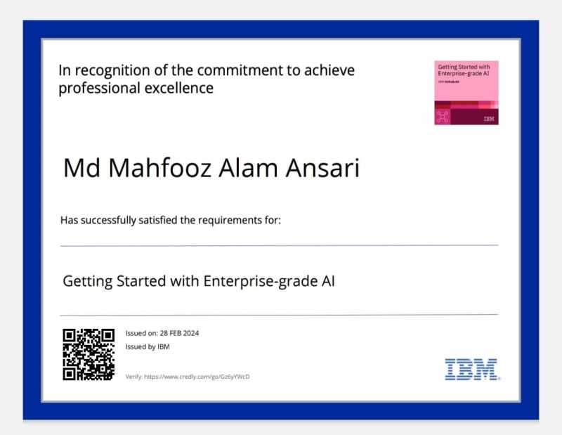
course certificate 1

Slide 12
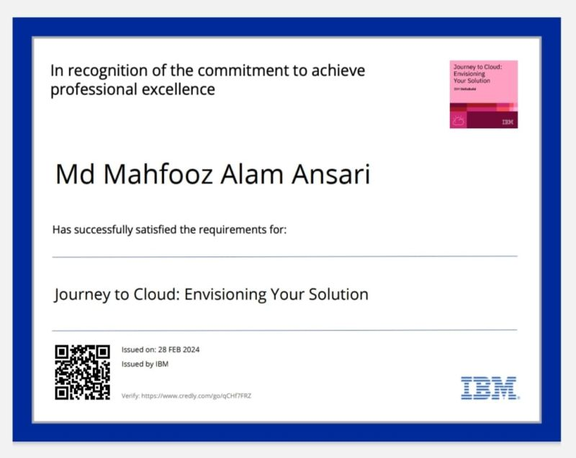
course certificate 2

Slide 13
THANK YOU

